Slide 1
Session 27
Segment Anything
From Clicks to Concepts — SAM, SAM 2 & SAM 3
Computer Vision & AI · One-on-One Series
Notes:
Welcome to Session 27. Today we cover the Segment Anything family — the models that turned image segmentation from a task-specific problem into a promptable, foundation-model problem. We finish with a live SAM 3 demo.

Slide 2
Today's Roadmap
≈ 1.5 hours · theory first, hands-on demo to finish
Introduction to Image Segmentation
10 min
SAM Variants — MobileSAM, FastSAM, SAM 2, SAM 3
10 min
1
6
What is SAM?
10 min
Real-World Applications & Limitations
5 min
2
7
How SAM Works Internally
15 min
Q&A
10 min
3
8
SAM Architecture Deep Dive
15 min
Live Demo — SAM 3 Inference
15 min
4
9
Different Types of Prompts
10 min
5
Notes:
Walk through the agenda. Roughly 50/50 theory and hands-on: about 75 minutes of concepts and discussion, then a 15-minute live demo of SAM 3.

Slide 3
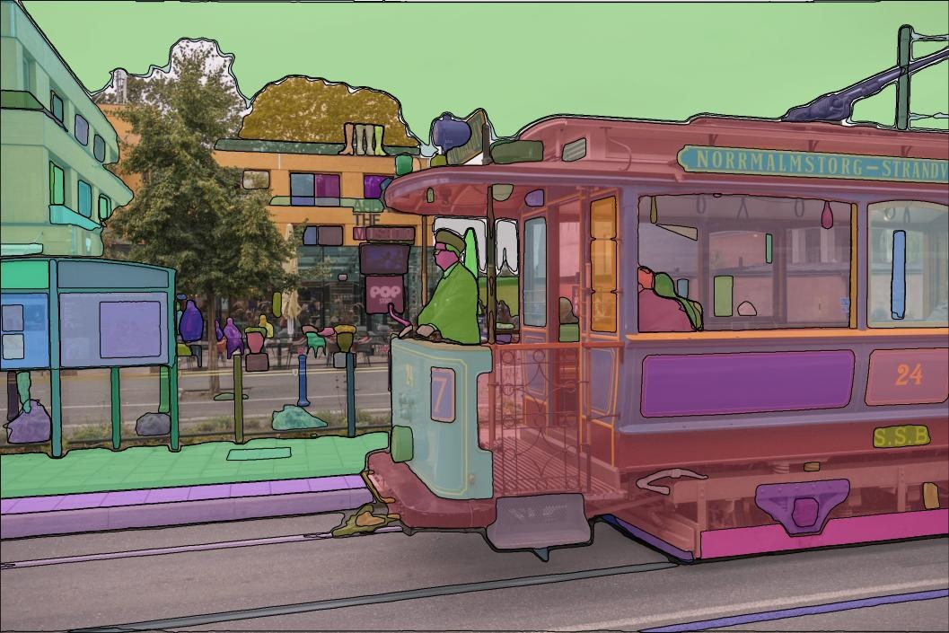
Introduction to Image Segmentation
From labels, to boxes, to pixels
Classification
“There is a dog in this image.”
One label for the whole image
Object Detection
“The dog is inside this box.”
Rectangles around each object
Segmentation
“These exact pixels are the dog.”
A pixel-accurate outline (mask)
Real SAM output — one mask per object, down to the pixel · Source: facebookresearch/segment-anything (GitHub)
Notes:
Start from what they know: classification says WHAT is in the image, detection adds WHERE with a box, segmentation answers exactly WHICH PIXELS. It is the finest-grained form of image understanding. The right image shows real SAM output — every object gets its own pixel-accurate mask.

Slide 4
Three Flavors of Segmentation
Same pixels, different questions
S
I
P
Semantic
Instance
Panoptic
“Which class does each pixel belong to?”
“Which object does each pixel belong to?”
“Both at once.”
All sheep share one label — no individuals. Background counts too (sky, grass, road).
Sheep #1 vs sheep #2 — each object gets its own mask. This is what SAM outputs.
Every pixel gets a class AND an instance identity — things (objects) + stuff (background).
Key link to today: SAM produces class-agnostic instance masks — it outlines objects without naming them.
Notes:
Three classic flavors. Semantic: label every pixel by class, no instances (all sheep = 'sheep'). Instance: separate each object (sheep #1, #2...) — this is what SAM produces. Panoptic: both at once, including background 'stuff' like sky and road. SAM's masks are class-agnostic instance masks — it does not name what it segments; that becomes important later when we reach SAM 3.

Slide 5
What is SAM?
Meta AI, April 2023 — a foundation model for segmentation
11M
1.1B
0-shot
images in the SA-1B training set
masks — ~400× larger than any prior dataset
segments new domains with no retraining
✓
A promptable model
You give it a hint — a click, a box, a rough mask — and it returns the segmentation mask you meant.
✓
General-purpose, not task-specific
Before SAM: one trained model per dataset/domain. After SAM: one model, any image, any object.
✓
An interface, like an LLM
Prompting replaces retraining — the same shift GPT brought to NLP, applied to computer vision.
Notes:
SAM = Segment Anything Model, released by Meta AI in April 2023. The pitch: a FOUNDATION MODEL for segmentation — like GPT for text, one model that segments anything you point at, zero-shot, without retraining. Trained on SA-1B: 11 million images, 1.1 billion masks — about 400x more masks than any prior dataset. The interface is a 'prompt': a click, a box, or a rough mask.

Slide 6
The Core Idea: Promptable Segmentation
One task to rule them all
Image
→
+ Prompt
→
SAM
→
Valid Mask
any photo, any domain
click · box · mask · text
one forward pass
+ confidence score
“Valid” beats “perfect”
A click can be ambiguous — shirt, or the person wearing it? SAM must return a reasonable mask for at least one meaning. That's why it can output multiple candidate masks.
The LLM parallel
Next-token prediction is a simple task that unlocked general language ability. Promptable segmentation plays the same role for vision: general pre-training + prompting instead of task-specific training.
Zero-shot transfer
Because the task is general, the trained model works out-of-the-box on medical scans, satellite images, paintings — domains it never saw labeled.
Notes:
The core design decision: define a new TASK — promptable segmentation. Given any prompt, return a VALID mask. 'Valid' is key: even when the prompt is ambiguous (a click on a shirt — did you mean the shirt or the person?), the model should output a reasonable mask for at least one interpretation. This mirrors next-token prediction in LLMs: a general pre-training task that transfers everywhere. Draw the pipeline: prompt + image → SAM → mask.

Slide 7
How SAM Works Internally
Three ideas that make it fast, robust and trainable
Encode once, prompt many
1
The heavy image encoder runs once per image (~0.45 s). Each new prompt only re-runs a lightweight decoder (~50 ms, runs in a browser) — segmentation becomes interactive.
Embrace ambiguity
2
One click could mean subpart, part, or whole object. SAM returns 3 candidate masks, each with a predicted quality (IoU) score, and lets you choose.
The data engine flywheel
3
Stage 1: SAM assists human annotators. Stage 2: semi-automatic (humans fill in what SAM missed). Stage 3: fully automatic — a 32×32 grid of point prompts generates SA-1B's 1.1 billion masks.
Notes:
Three engineering ideas make SAM work. (1) Asymmetric design: run the heavy image encoder ONCE (~0.45s), then answer every new prompt with a tiny decoder in ~50 ms — that's what makes it feel interactive in a browser. (2) Ambiguity-awareness: output 3 masks (subpart / part / whole) with predicted IoU scores, pick the best. (3) The data engine: model helps humans annotate → more data trains a better model → repeat. Final stage was fully automatic: prompt the model with a grid of points to produce 1.1B masks.

Slide 8
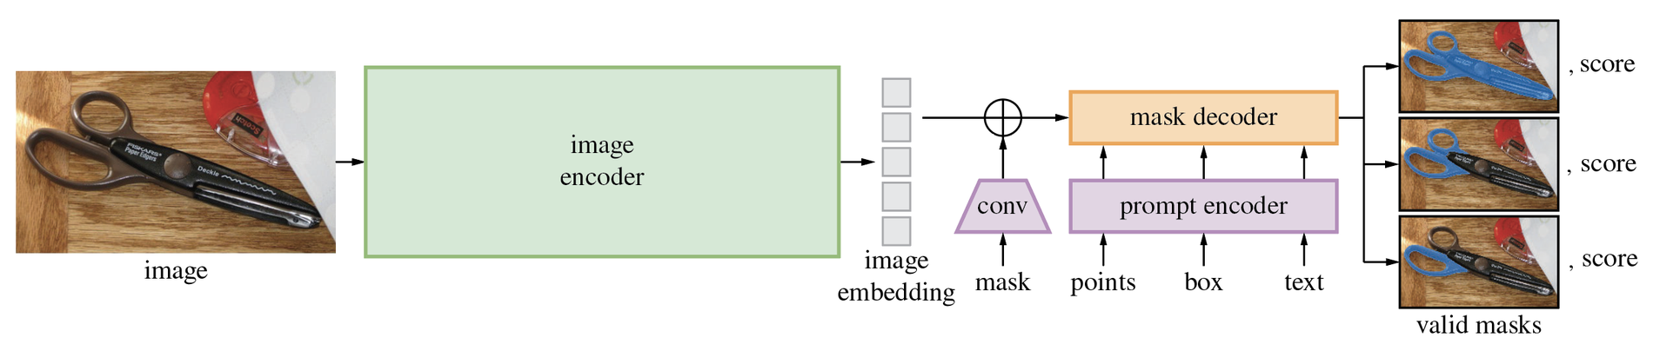
SAM Architecture — The Big Picture
Official diagram, Meta AI (segment-anything repo)
Source: github.com/facebookresearch/segment-anything — assets/model_diagram.png
Runs once per image
Runs per prompt
Output
Image encoder → embedding. All the heavy compute lives here.
Prompt encoder + mask decoder — light enough for real time.
Three candidate masks + a score for each — ambiguity resolved by choice.
Notes:
This is the official architecture figure from Meta's segment-anything repository. Walk it left to right: image → image encoder → image embedding (computed once). Below: prompts (points, box, text) go through the lightweight prompt encoder; a rough mask prompt is added to the embedding via convolutions. The mask decoder combines embedding + prompts and outputs three valid masks, each with a confidence score.

Slide 9
Architecture Deep Dive — Three Components
What's inside each block
Image Encoder
Prompt Encoder
Mask Decoder
ViT-H · 632M params
lightweight · flexible
2-layer two-way transformer
Pre-trained with MAE (masked autoencoders)
Input 1024×1024 → embedding of 64×64×256
~95% of total compute — but runs only once
Sparse: points & boxes → positional + learned embeddings
Text → CLIP text encoder (exploratory in SAM 1)
Dense: rough masks → added to embedding via conv
Prompt tokens ↔ image embedding attend to each other
Outputs 3 masks (subpart / part / whole)
A small IoU head scores each mask's quality
Design rule: put the intelligence in the encoder, keep the decoder light enough for real-time interaction.
Notes:
Deep dive on each block. Image encoder: ViT-H, 632M params, pre-trained with MAE (masked autoencoding), input 1024x1024, output a 64x64x256 embedding. Prompt encoder: sparse prompts (points/boxes) become positional encodings + learned type embeddings; text used CLIP's encoder in the paper; dense prompts (masks) are added to the embedding via convolutions. Mask decoder: a 2-layer 'two-way' transformer — tokens attend to image and image attends to tokens — then upsampling; separate small head predicts IoU (quality) per mask. 3 output masks handle ambiguity.

Slide 10
Different Types of Prompts
How you tell SAM what you mean
Points
SAM 1+
Boxes
SAM 1+
Masks
SAM 1+
Click on the object. Positive points include, negative points exclude. Iterate clicks to refine the mask.
Draw a rectangle around the object — the least ambiguous single prompt.
Provide a rough mask (e.g. from a previous model) — SAM returns a cleaned-up version.
Text
SAM 3
Exemplars
SAM 3
Combined
SAM 3
A short noun phrase — “yellow school bus”. Segments every matching instance at once.
Box one example object — SAM 3 finds all other instances of the same concept.
Mix them: text + negative box = “all handles, but not the oven handle”.
SAM 1 & 2 answer “segment THIS thing” → SAM 3 also answers “segment ALL such things”.
Notes:
All the ways to talk to SAM. Points: positive clicks say 'include this', negative clicks say 'not this' — iterate to refine. Boxes: strongest single prompt, little ambiguity. Masks: rough input mask refined into a clean one. Text: exploratory in SAM 1; became a first-class citizen in SAM 3, where a noun phrase like 'yellow school bus' segments ALL matching instances. Exemplars (SAM 3): show one example box, get every similar object. Emphasize: prompts compose — text + a negative box, etc.

Slide 11
The SAM Family Tree
Two community forks, then two Meta leaps
Apr 2023
Jun 2023
Nov 2025
SAM
MobileSAM
SAM 3
the original — promptable masks
distilled encoder — 60× smaller
concepts: text & exemplar prompts
Jun 2023
Jul 2024
FastSAM
SAM 2
CNN (YOLOv8-seg) — ~50× faster
video + streaming memory
Two pressures drove the family: speed/size (FastSAM, MobileSAM) and capability (SAM 2 video, SAM 3 concepts). SAM 3.1 (Mar 2026) added faster multi-object tracking.
Notes:
The family tree. April 2023: original SAM. Within two months, two community answers to its speed problem: FastSAM (replace the pipeline with a fast CNN detector) and MobileSAM (distill the encoder ~60x smaller). July 2024: Meta's SAM 2 adds video with a streaming memory. November 2025: SAM 3 adds concept prompts — text and exemplars — plus a detector-tracker design. March 2026: SAM 3.1 checkpoints with faster multi-object tracking.

Slide 12
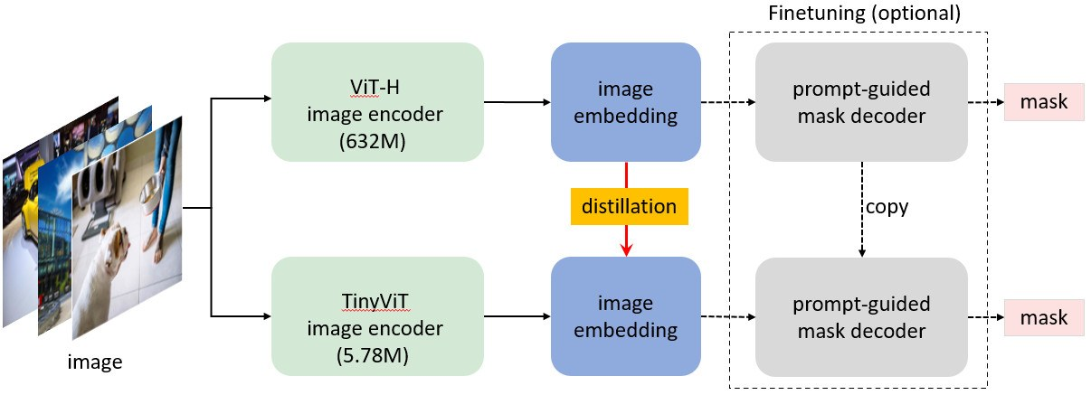
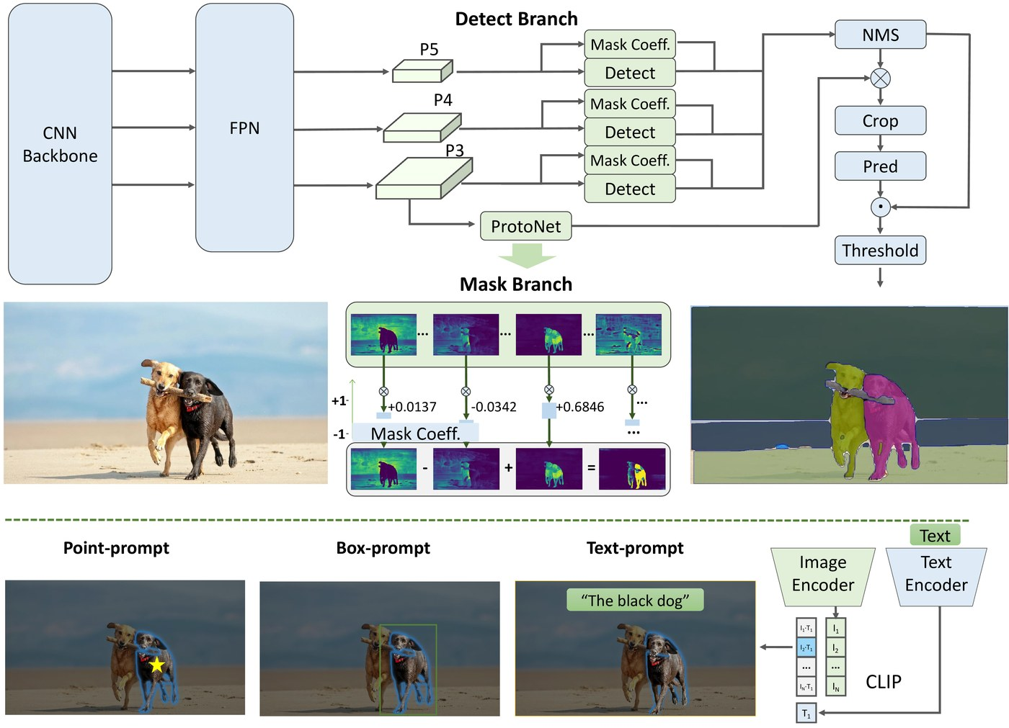
Making SAM Small & Fast
MobileSAM distills it — FastSAM rebuilds it
MobileSAM — distillation
FastSAM — a CNN re-think
Source: github.com/ChaoningZhang/MobileSAM
ViT-H (632M) → TinyViT (5.78M) encoder, ~60× smaller
Student mimics teacher embeddings — decoder unchanged
Runs on mobile/edge; same point & box prompting
Source: github.com/CASIA-IVA-Lab/FastSAM
YOLOv8-seg segments all objects in one CNN pass
Prompt (point/box/text) then selects the right mask
~50× faster than SAM; coarser mask edges
Notes:
Two different answers to 'SAM is too slow'. MobileSAM keeps SAM's architecture but replaces the 632M ViT-H encoder with a 5.78M TinyViT trained by DISTILLATION — the small encoder learns to reproduce the big encoder's embeddings, so the same decoder still works. FastSAM abandons the architecture entirely: a YOLOv8-seg CNN segments everything in one pass, then a second stage selects the mask matching your prompt. Trade-off: MobileSAM keeps SAM's interface and quality profile; FastSAM is very fast but less precise on edges.

Slide 13
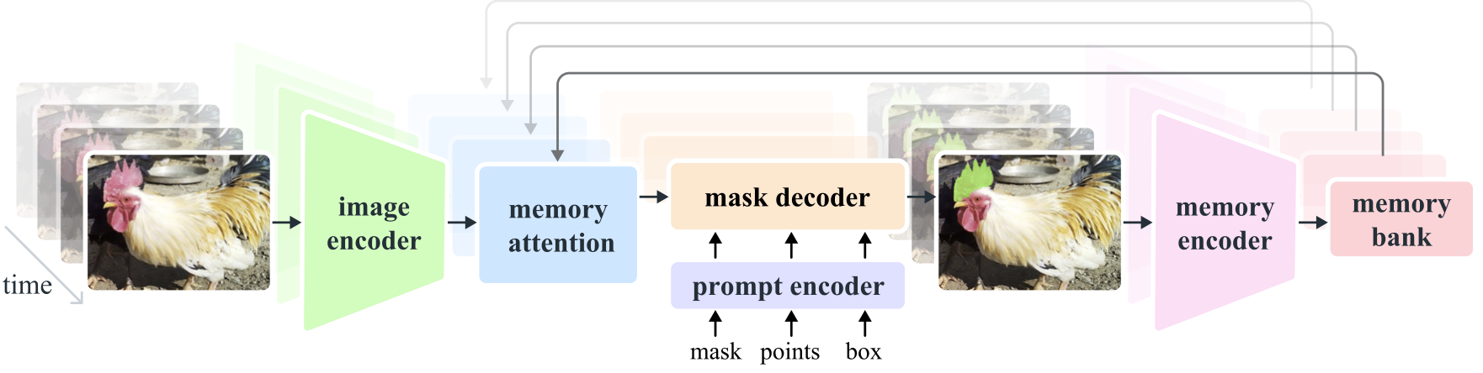
SAM 2 — Segmenting Moving Pictures
Promptable segmentation + streaming memory (Jul 2024)
Source: github.com/facebookresearch/sam2 — assets/model_diagram.png
Memory bank
Prompt any frame
Faster everywhere
Past frames + prompted frames are stored and attended to — the object follows through the video.
Click on frame 1 or frame 100 — corrections propagate through the memory.
New Hiera encoder: ~6× faster than SAM 1 on images, ~44 FPS on video.
Notes:
SAM 2 (July 2024) extends promptable segmentation to VIDEO. The key addition is memory: after segmenting a frame, a memory encoder writes it to a memory bank; on the next frame, memory attention conditions the features on past frames, so the object is tracked without new prompts. You can click on any frame to add or fix an object. New Hiera encoder makes it ~6x faster than SAM 1 on images too, and it runs at ~44 FPS on video. Trained on SA-V: 51k videos, 600k+ masklets.

Slide 14
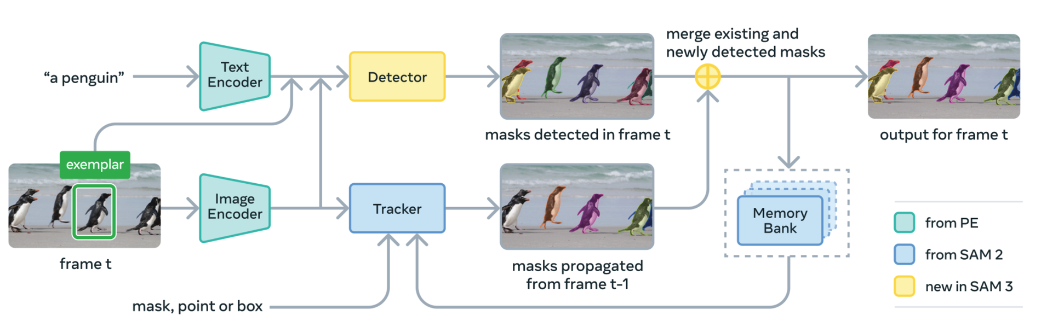
SAM 3 — Segment Anything with Concepts
From “this thing” to “every such thing” (Nov 2025)
Source: github.com/facebookresearch/sam3 — assets/model_diagram.png
Detector (DETR-based, new) finds all instances of the concept · Tracker (from SAM 2) follows them through video · Presence token decouples “is it there?” from “where?” · 848M params · 75–80% of human cgF1 on SA-Co
Notes:
SAM 3 (Nov 2025) changes the QUESTION. SAM 1/2: 'segment this thing I'm pointing at' — one object per prompt. SAM 3: 'segment every instance of this concept' — Promptable Concept Segmentation. Prompts are noun phrases or exemplar boxes. Architecture: a DETR-based detector and the SAM 2-style tracker share one Perception Encoder backbone (848M total). A 'presence token' separates recognition (is a red player present?) from localization (where?), which sharpens discrimination between similar concepts. Trained via a data engine with 4M concepts; evaluated on SA-Co (270k concepts) where it reaches 75-80% of human performance. This is the model we demo today.

Slide 15
The Family at a Glance
Choosing the right SAM for the job
Model | Year | Core idea | Prompts | Reach for it when…
SAM | 2023 | Promptable masks, ViT-H + light decoder | point · box · mask | Best-quality interactive masks, GPU available
MobileSAM | 2023 | Distilled TinyViT encoder (60× smaller) | point · box · mask | Mobile & edge deployment
FastSAM | 2023 | YOLOv8-seg CNN, segment-everything-first | point · box · text* | Real-time speed over edge precision
SAM 2 | 2024 | Streaming memory for video, Hiera encoder | point · box · mask (any frame) | Video object segmentation & tracking
SAM 3 | 2025 | Concept prompts; detector + tracker | + text phrase · exemplar | “Segment ALL the X”, open vocabulary
* FastSAM's text prompting matches masks against CLIP embeddings — slower and less reliable than its point/box modes.
SAM 3 also handles SAM 1/2-style visual prompts — one model, both questions.
Notes:
Side-by-side recap. Use this to answer 'which one should I use?' — edge/mobile: MobileSAM or FastSAM; interactive image annotation: SAM 1 or SAM 2; video: SAM 2; open-vocabulary / text-driven segmentation of all instances: SAM 3. Note SAM 3 still supports SAM 1/2-style visual prompting, so it's largely a superset.

Slide 16
Real-World Applications & Limitations
Where it shines, where it strains
Applications
Limitations
Annotation at scale
Compute & latency
Click-to-mask labeling in Roboflow, CVAT, Label Studio — 10× faster datasets
Foundation-scale encoders still want a GPU; edge needs the distilled variants
Medical imaging
Fine structures
MedSAM & fine-tunes for organs, tumors, cells
Hair, wires, thin fences remain hard for crisp masks
Video editing & VFX
Short phrases only
SAM 2/3 tracking for rotoscoping and object effects
SAM 3 handles noun phrases, not reasoning — “the dog furthest left” needs an MLLM on top (SAM 3 Agent)
Robotics · AR · Geospatial
Domain gaps
Grasping targets, scene understanding, building footprints from satellites
Exotic modalities (CT, sonar, thermal) still reward fine-tuning
Notes:
Where this is used today: annotation tools (Roboflow, CVAT, Label Studio use SAM to turn hours of polygon-drawing into clicks), medical imaging (MedSAM and derivatives), video editing / VFX (SAM 2 tracking for rotoscoping), robotics & AR (object picking, scene understanding), geospatial (building/field extraction from satellite imagery). Limitations to be honest about: compute for the big encoders; fine structures (wires, hair) still break; text understanding in SAM 3 is short noun phrases, not full sentences — 'the second-largest dog' needs an MLLM on top (SAM 3 Agent); domain gaps (e.g. some medical modalities) still benefit from fine-tuning.

Slide 17
Questions & Discussion
Things worth debating:
Why did “promptable” beat “end-to-end” for general segmentation?
When would you still train a dedicated segmentation model instead of using SAM?
SAM 3's presence token separates “what” from “where” — why does that help?
How would you combine SAM 3 with an LLM to answer “segment the dog furthest from the camera”?
Notes:
Open discussion — 10 minutes. Prompts on screen if the conversation needs a spark.

Slide 18
Live Demo — SAM 3 Inference
Session_27_SAM3_Practical.ipynb
Get access
the whole API, in one breath
1
Request access to facebook/sam3 on Hugging Face (it's gated) and create an access token
from transformers import (
Sam3Model, Sam3Processor)
model = Sam3Model
.from_pretrained("facebook/sam3")
proc = Sam3Processor
.from_pretrained("facebook/sam3")
inputs = proc(images=img,
text="player in white")
outputs = model(**inputs)
res = proc.
post_process_instance_segmentation(
outputs, threshold=0.5)
Open in Colab
2
GPU runtime (T4 is enough) · pip install transformers · log in with your token
Prompt with text
3
“player in white” → masks + boxes + scores for every matching instance
Prompt with exemplars
4
Box one object → SAM 3 finds all the others · combine text with negative boxes
Fallback if no GPU / no HF access: play with the hosted demo at segment-anything.com
Notes:
Switch to the notebook: Session_27_SAM3_Practical.ipynb. Checklist before the session: (1) request access to facebook/sam3 on Hugging Face (gated — approve takes minutes), (2) create an HF access token, (3) open the notebook in Colab with a GPU runtime (T4 is fine). Demo flow: text prompt segments all matching instances; exemplar box prompt; combined text + negative box; visualize masks, boxes, scores.

